Slide 1

Introduction to Online Event Management System
Name:A.Maheswari
Reg No:192211991
Guided By:Javasakthivelmurugan
Page No:1

Slide 2
Agenda
Introduction
1
An overview of the online event management system and its purpose.
2
System Architecture
Exploration of the system's design, components, and underlying technologies.
Modules and Features
3
A detailed look at the system's key modules and their functionalities.
4
Benefits and Advantages
Highlighting the benefits of using this system for event management.
Conclusion and Future Enhancements
5
Summary of the system's capabilities and plans for future development.
6
References
Listing of sources and resources used in this presentation.
Page No:2

Slide 3

Objective of the Project
Streamline Event Planning
Enhance Communication
Simplify and automate various tasks involved in event planning, saving time and resources.
Facilitate seamless communication among event organizers, attendees, and stakeholders.
Improve Efficiency
Boost Event Success
Optimize event operations, including registration, ticketing, scheduling, and logistics.
Maximize event reach, engagement, and overall success by leveraging digital tools and technology.
Page No:3

Slide 4
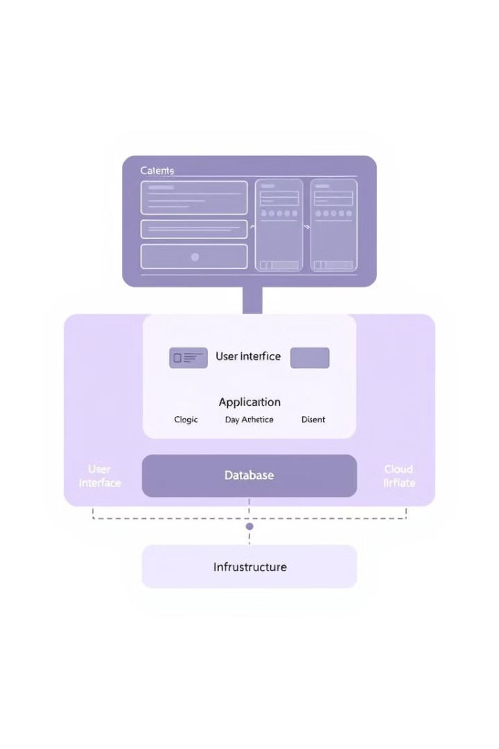




System Architecture
Front-End
User interface for event registration, management, and communication.
Back-End
Server-side logic handling data processing, user authentication, and event operations.
Database
Storage for event information, user data, and system configurations.
Cloud Infrastructure
Scalable and reliable hosting environment for the system's components.
Page No:4

Slide 5
Proposed System and its Advantages
User-Friendly Interface
Comprehensive Functionality
Scalability and Flexibility
Intuitive design for seamless event planning and management.
Adaptable to different event sizes and requirements.
Covering all aspects of event management, from registration to reporting.
Page No:5

Slide 6

Listed Modules
1
Event Creation and Management
2
Registration and Ticketing
Tools for creating, configuring, and managing event details.
Online registration forms and ticketing options for attendees.
3
Attendee Management
4
Scheduling and Logistics
Managing attendee information, communication, and engagement.
Organizing event schedules, venues, and logistics.
Page No:6

Slide 7





Event Promotion and Marketing
Social Media Integration
Email Marketing Campaigns
Sharing event information and updates across various social platforms.
Targeted email campaigns to promote the event and attract attendees.
Website Integration
Performance Tracking
Seamless integration with event websites for registration and information access.
Monitoring marketing campaign effectiveness and audience engagement.
Page No:7

Slide 8
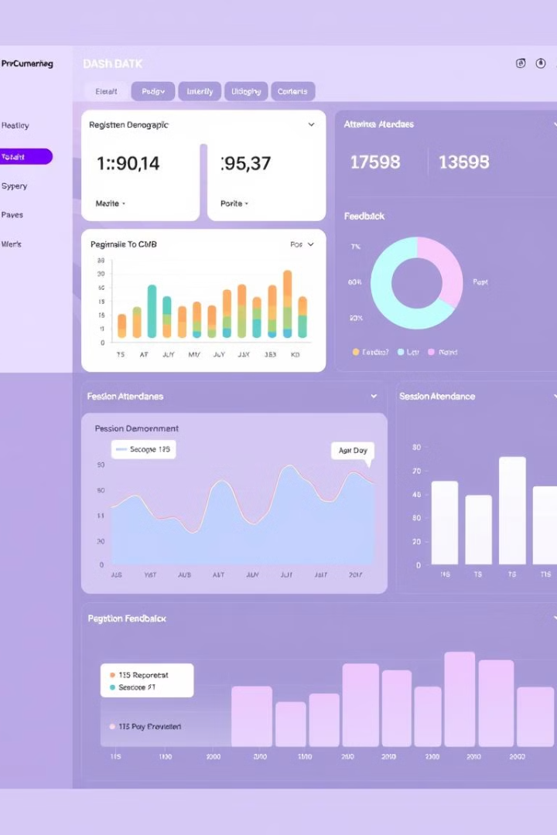
Analytics and Reporting
Metric
Description
Registration Numbers
Total number of attendees registered for the event.
Attendee Demographics
Analysis of attendee profiles, including age, location, and industry.
Session Attendance
Tracking attendance for individual sessions and events.
Feedback and Surveys
Collecting and analyzing attendee feedback and satisfaction levels.
Page No:8

Slide 9
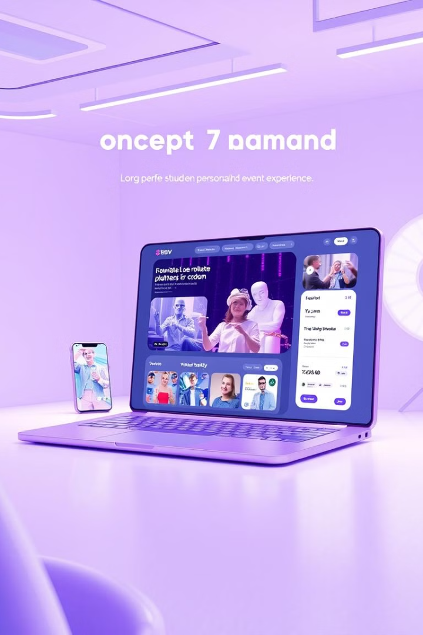
Conclusion and Future Enhancements
This online event management system provides a comprehensive solution for planning and managing events. Future enhancements include incorporating virtual reality experiences, artificial intelligence-powered personalization, and advanced analytics tools.
Page No:9

Slide 10

References
The references section will provide a list of sources and resources used in the development of this system. These resources offer valuable insights into best practices, technical guidelines, and industry trends.
Page No:10

